Slide 1

Chapter 6 – part II

Slide 2
OUTLINE
  Work with varying forces.
  Work along a curved path.
  Power.
  Problems.

Slide 3
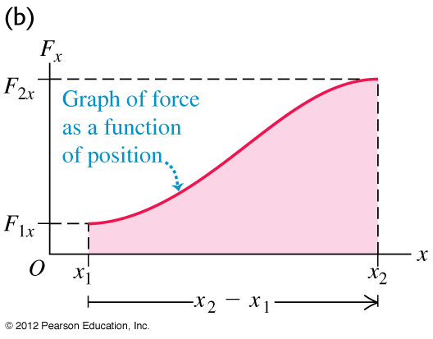
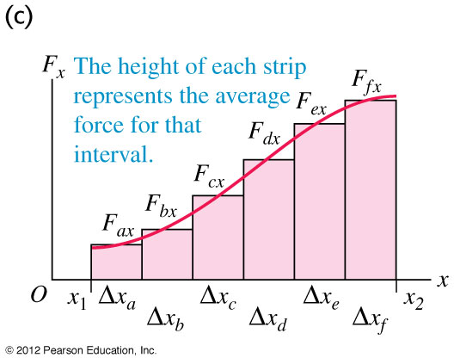
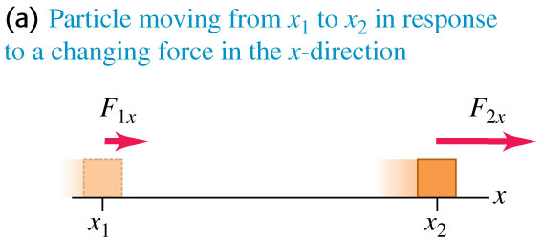
Work and energy with varying forces
  Many forces, such as the force to stretch a spring, are not constant.
  In Figure, we approximate the work by dividing the total displacement into many small segments.

Slide 4
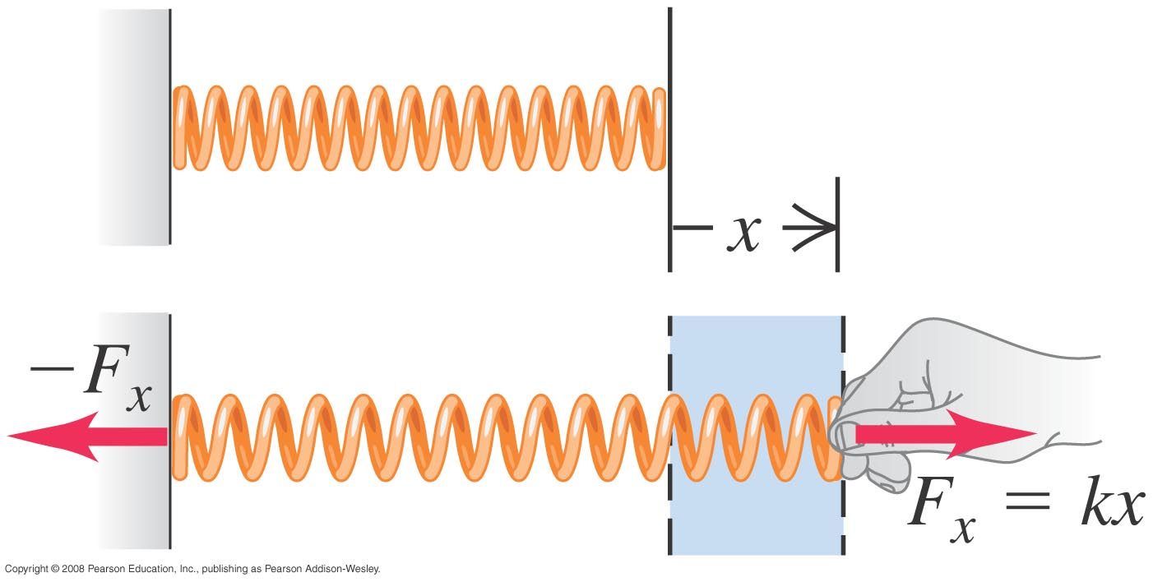
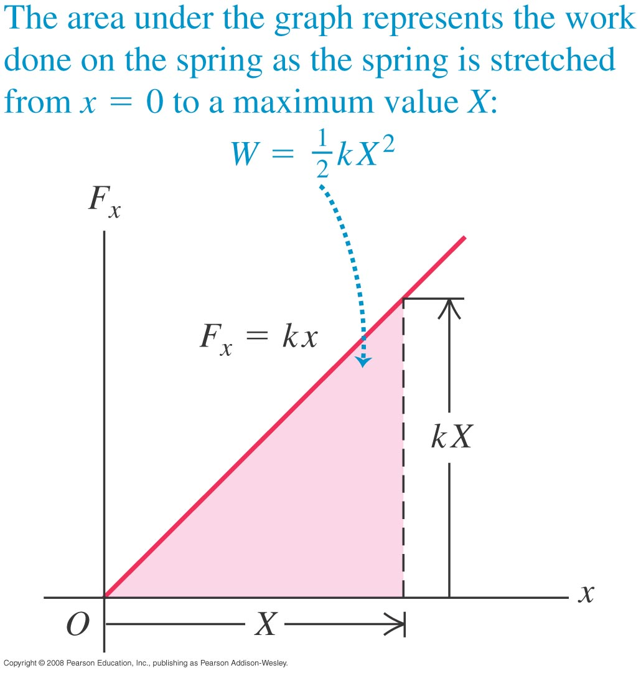
Stretching a spring
  The force required to stretch a spring a distance x is proportional to x: F_{x} = kx.
  k is the force constant (or spring constant) of the spring.
  The area under the graph represents the work done on the spring to stretch it a distance X: W = 1/2 kX².

Slide 5
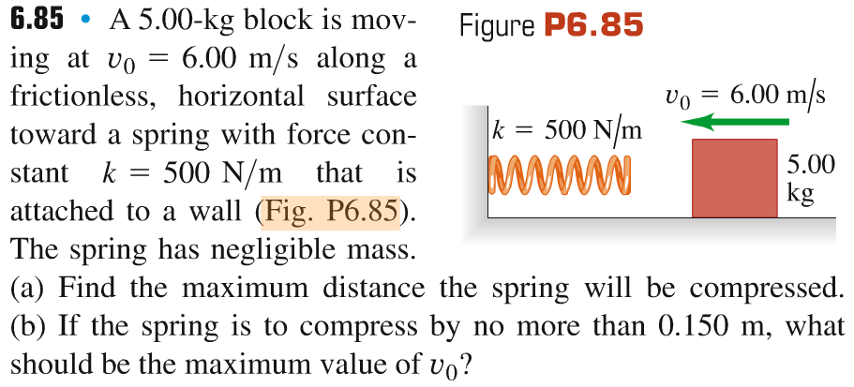
Problem #1

Slide 6
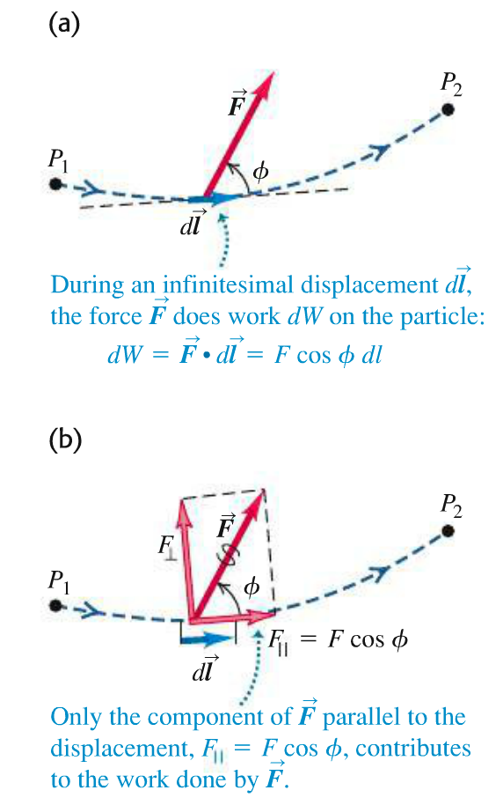
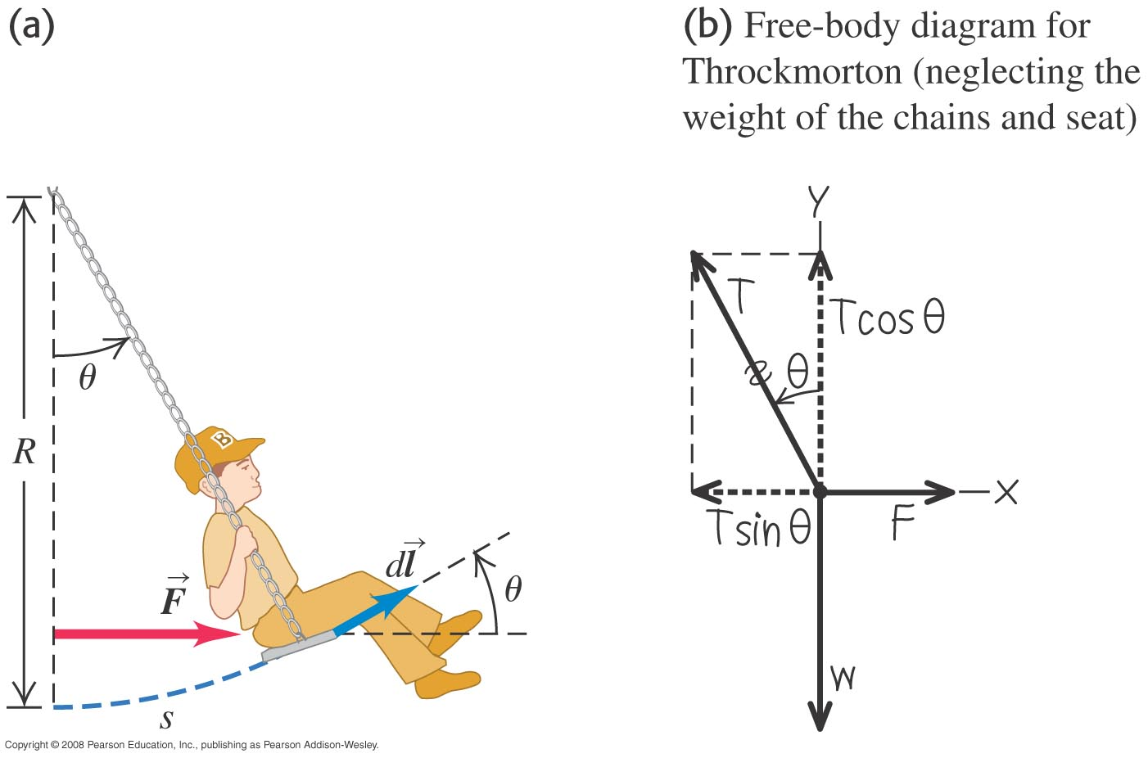
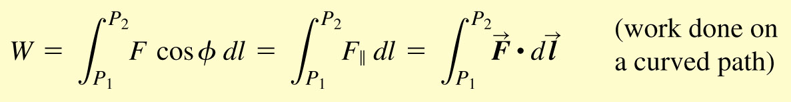
Motion on a curved path

Slide 7
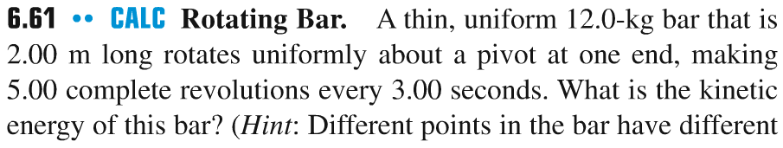
Problem #2

Slide 8
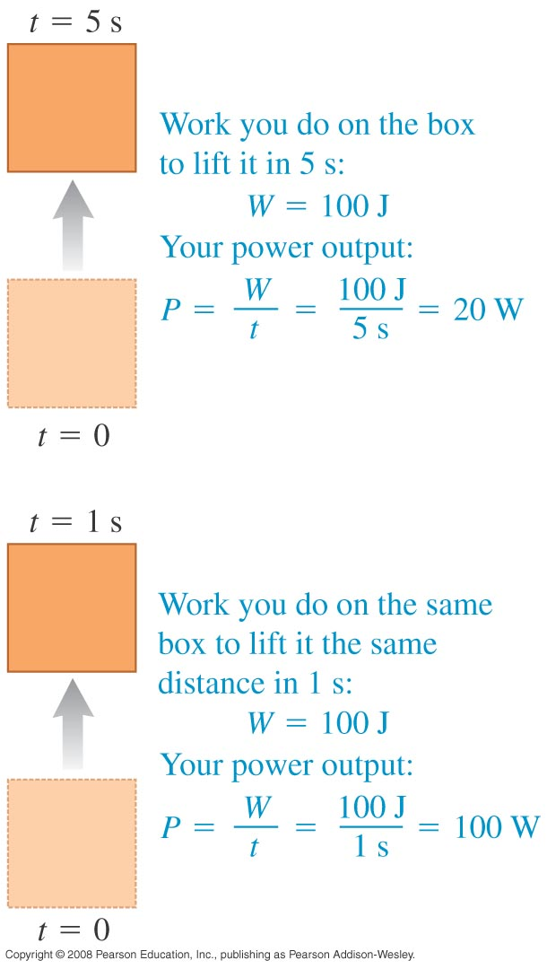
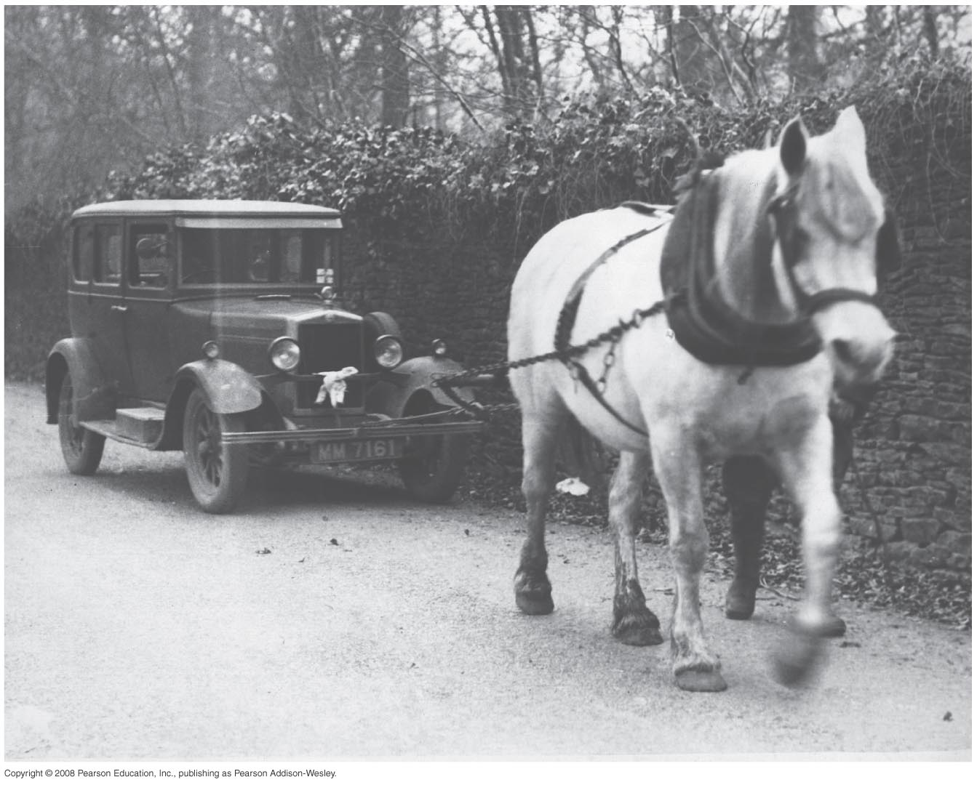
Power
Power is the rate at which work is done.
Average power is P_{av} = ΔW/Δt and instantaneous power is P = dW/dt.
The SI unit of power is the watt (1 W = 1 J/s), but other familiar units are the horsepower and the kilowatt-hour.

Slide 9
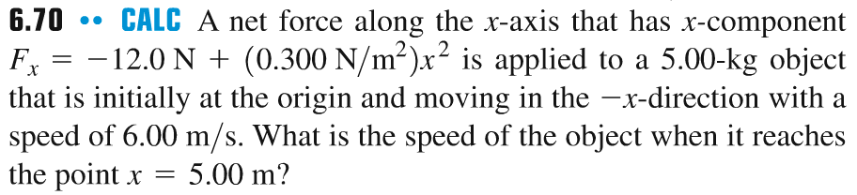
Problem #3
x = - 5 m

Slide 10
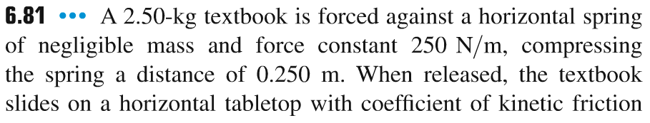
Problem #4

Slide 11
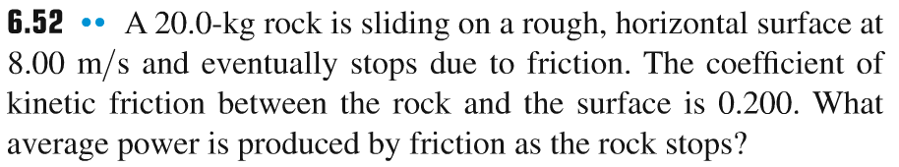
Problem #5

Slide 12
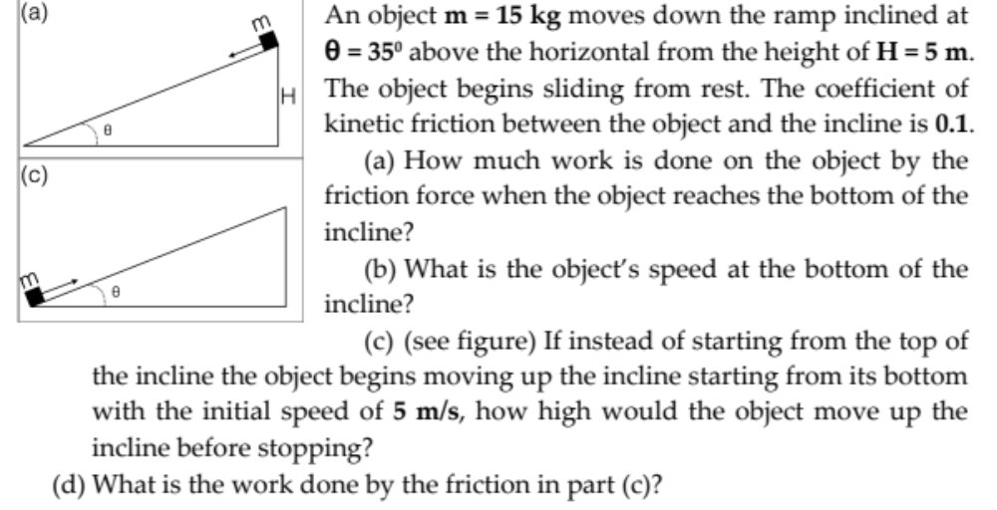
Problem #6

